Slide 1
MINI Project Report on “CHAT APPLICATION”
GROUP MEMBERS:-
Sanskruti Kokare – 45
Harsh Sawant – 46
Pratyush Lokhande – 47
Vatsal shah – 48
Project Guide:-
Vaishali Shirsath mam

Slide 2
CONTENTS: -
Introduction
Problem Statement
Flowchart
Requirements
Challenges Faced
Current Status and Future Plan
Conclusion

Slide 3
Introduction:-
CHATTING APPLICATION IS DESKTOP BASED APPLICATION
The client server chat application is based on java swing and user socket packages. Its simple and easy and requires only core java knowledge. This application/program is good example of using java.io java.net packages to create a chat application.
Chatting is the method of using technology to bring people and ideas “together” despite of the geographical barriers.
It is made up of 2 applications the client application, which runs on the users Pc and server application, which runs on anyone Pc on the network. To start chatting client should get connected to server.

Slide 4
Problem statement:-
Communication is one of the most important part of daily life. There are many different means of communication. One such means of communication. One such means is chatting. There will be hardly any person who does not use a chat application nowadays.
Chat server is network based application. Even though its small application, but eligible to meet client – side requirements. It will be made using graphical components in the swing toolkit in java.

Slide 5
Flow of program:-
The aim of this project is how we can implement a simple chat application between a server and client. The application is desktop based and is implemented using swing and awt. The project is developed in java SE language executed on single alone java across a network using loop back address concept.
Application consists of two programs:
Server
Client

Slide 6
Flowchart:-
Server
The server module of the application waits for the client to connect to it. The duty of the server is to let clients exchange the messages.
it can mutually communicate with the server.
Client
The client module is the one that utilizer sends requests to the server. Utilizer utilizes the client as the means to connect to the server. The connection can communicate to the connected server.

Slide 7
Requirements:-
External Interface Requirements
USER INTERFACE:
The user interface required to be developed for the system should be user friendly and attractive. There are two sets of Java APIs for graphic programming:
AWT (Abstract Windowing Toolkit) and swing.
AWT API was introduced in JDK 1.0.Most of the AWT components have become obsolete and should be replaced by newer Swing components.
Swing API, a much more comprehensive set graphics libraries that enhances the AWT, was introduced as part of Java Foundation Classes (JFC) after and the release of JDK 1.1. JFC consists of Swing, Java2D,Accessiblity, Support APIs. JFC was an add-on to JDK 1.1 but has been integrated into core Java since 1.2.
SOFTWARE INTEFACE:-
Programming Language Java and socket programming

Slide 8
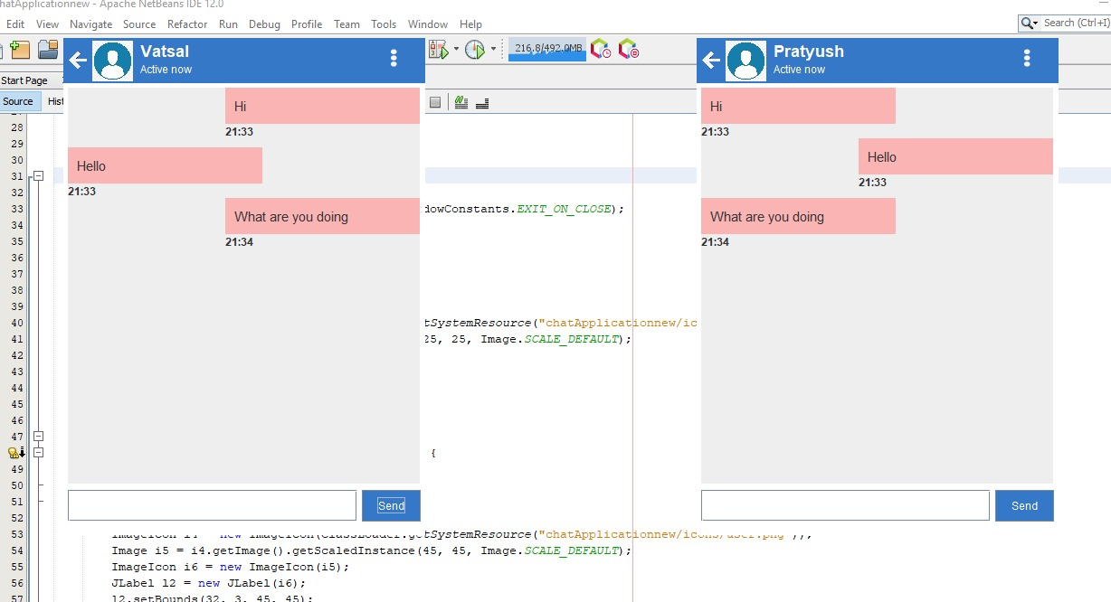
Preview of Client Server Screen or user interface:

Slide 9
Challenges Faced
1) Learning all concepts in a small amount of time.
> Each group member learned certain concepts in a week and then later we taught each other what we learned. So every member got idea about every topic.
2) How to change the status from active now to typing.
> Used 2 action listeners, 1 for active now which is always on and 2nd for typing which has a Boolean expression which turns true when any key is pressed on the Jlabel.

Slide 10
3) Adjustment of user interface
> since it is a chat application, we can expect many people to be using this. So the user interface should be easy and should not be such that the user gets confused. For this we kept the interface as minimalistic as possible with the maximum of functionality.
4) What happens if message screen gets filled
> if numerous chats were done then the visible text field got full and other chats could not be seen. To rectify this situation we added a scroll bar which would help us navigate the text field and allow us to see all messages.

Slide 11
Current Status & future plan :
Current Status:
We have currently design individual chat sever, With which we can send and receiver a text message and start up with a communication by two individual personality.
Future Plan:
There is always a scope for improvement and adding on new this according to the demand of the public. But the most important thing should be flexible to accept further modification. In future the software maybe extended to include features such as:
Chat saving: This will save all the messages sent by the server and client in a file.
Group chat: Currently there can be only 2 users but we plan to extend this in such a way that multiple users can chat together.

Slide 12
Conclusion:
We have developed network application in java using swing and other different packages of java. These software is portable, efficient and easily maintainable for large number of clients. Our developed web based chatting software is unique in its features and more importantly easily customizable.

